Slide 1
Dallas County Residential Home Value Analysis
Team Members:
Julas Hollie
Marcus Kim
John Millar
Joe Swiderski

Slide 2
Introduction
Overview
Analysis of Dallas County home prices over the previous 5 years with the intent to determine which factors influenced property values
School District
Property Type [Affordable, First Time, Affluent, Luxury]
Macroeconomic factors [GDP, Unemployment, S&P500]
Goal
Based on analysis, determine the best investment over the next 3 years in Dallas home market
Methodology
Dallas County Appraisal District (CAD) total home value was used to value the properties. CAD values were used as a proxy for market values.
Conclusion
Dallas residential home market: favorable

Slide 3
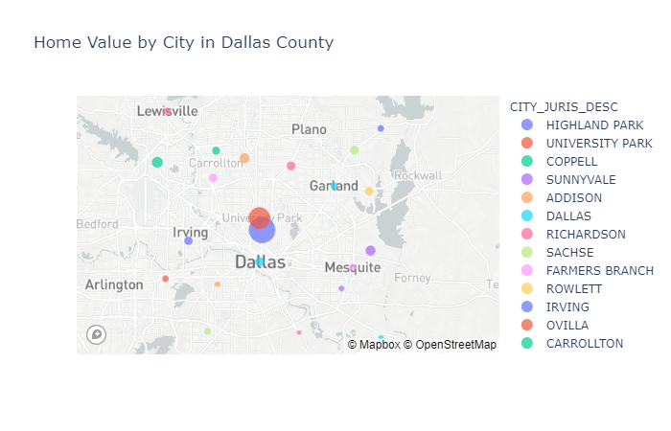
Property Values by City
Size = Property Value

Slide 4
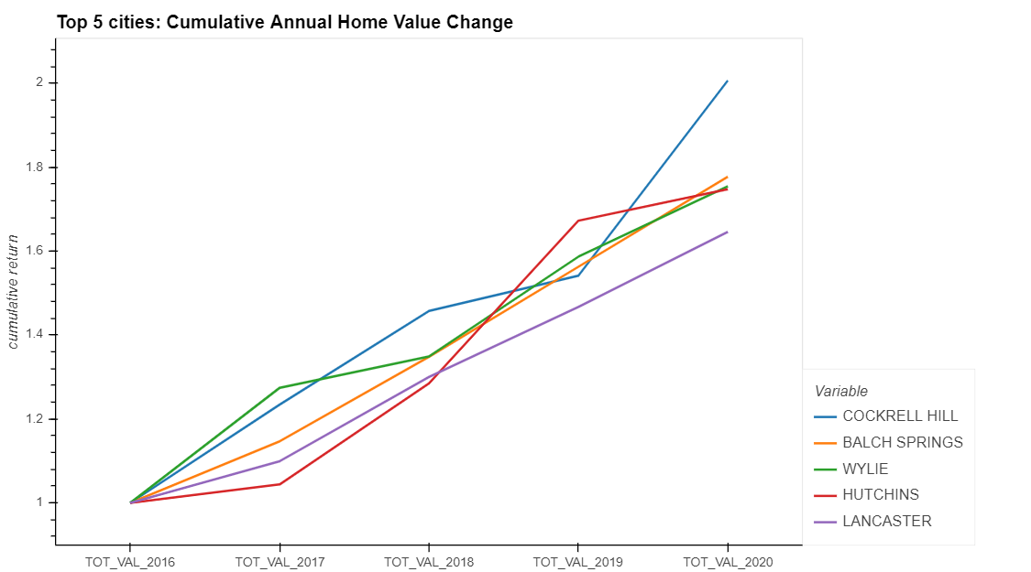
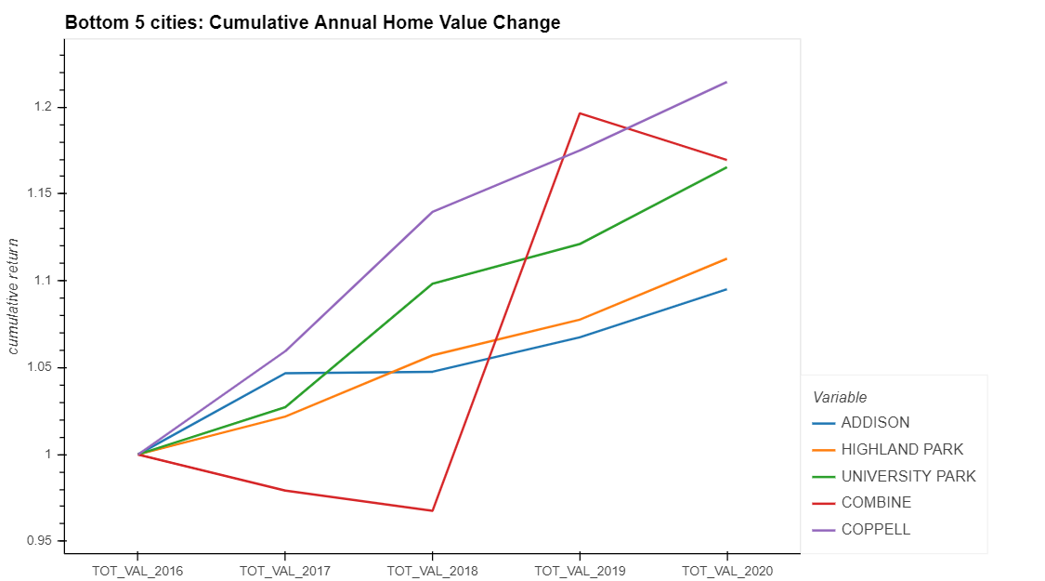
5 Year Return: Top 5 & Bottom 5 Cities
Notes:
Percentage (cumulative) chart by city – line chart
Top 5
Bottom 5

Slide 5
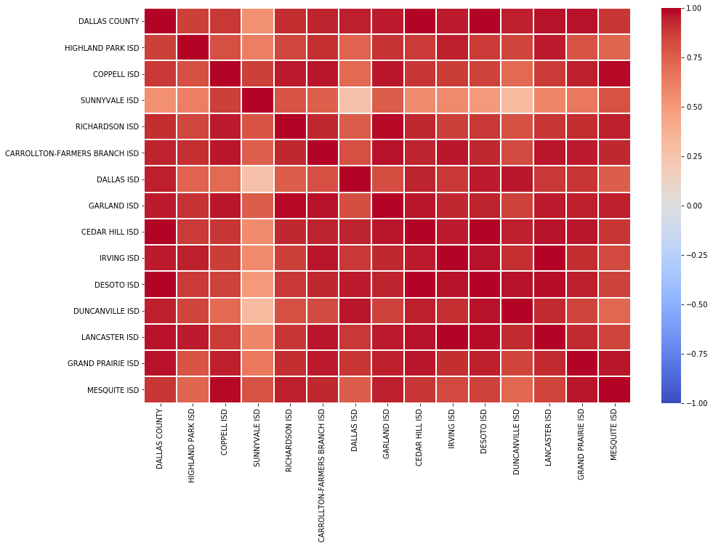
School District (ISD) Differentiation

Slide 6
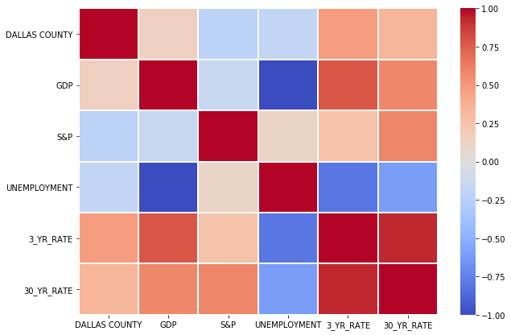
Macroeconomic Influence
Notes:
Heat map for Dallas County vs. Market

Slide 7
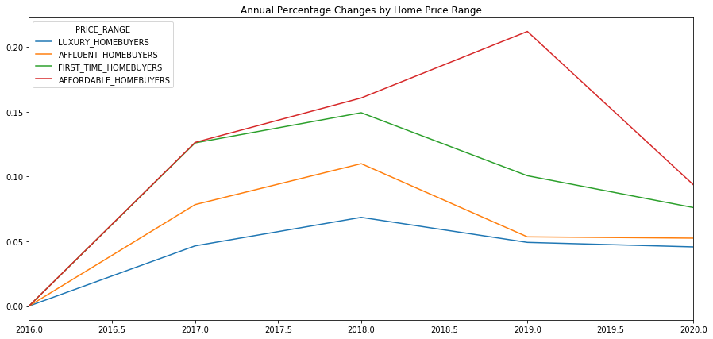
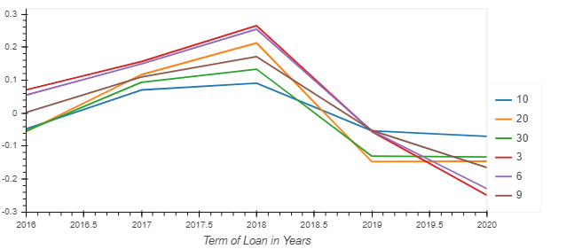
Interest Rate Impact
Notes:
Line chart by property type + interest rates

Slide 8
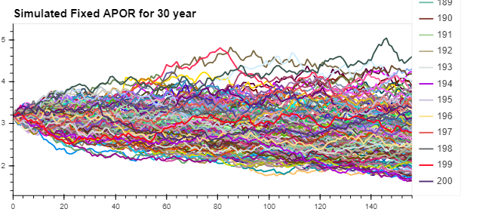
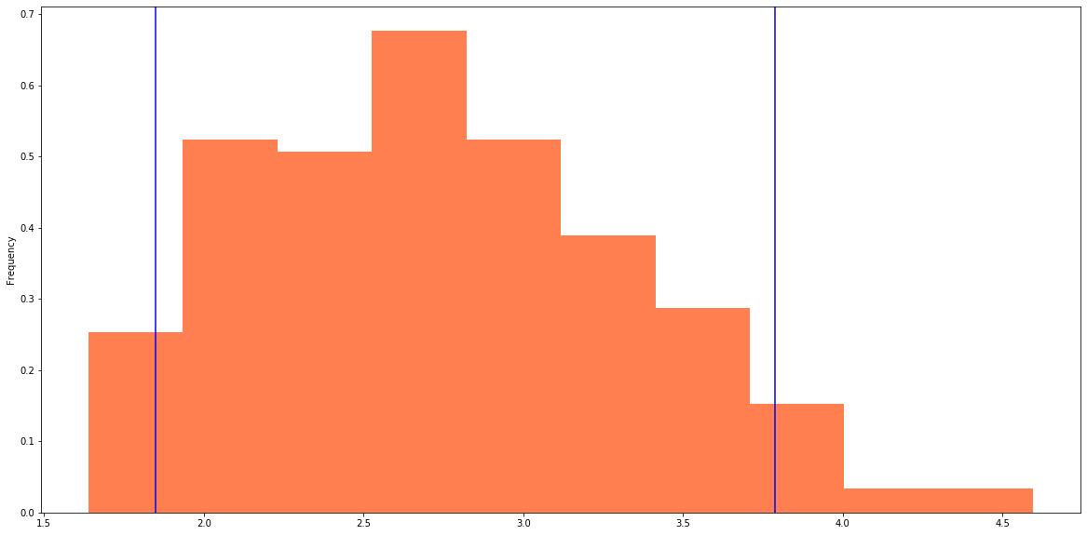
Monte Carlo
Notes:
Line chart by property type + interest rates

Slide 9
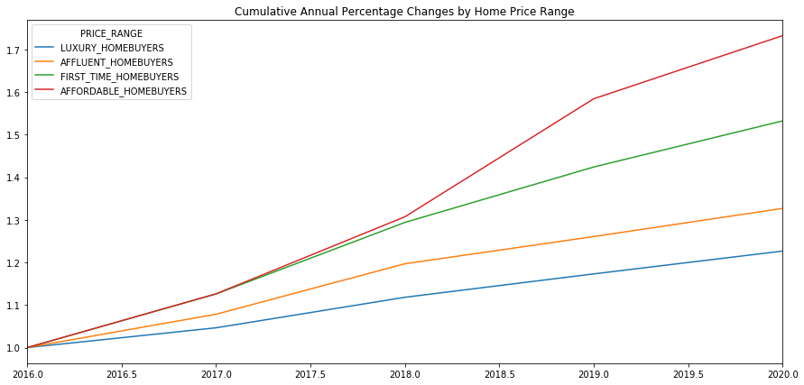
Value by Property Type
Notes:
Property Feature
Affordable, luxury, etc.
Bubble chart real time walkthrough (switch to jupyter)

Slide 10
Summary
Hypothesis
Conclusion
Location, location, location – school districts are a significant differentiator relative to appreciation
False. school district differentiation is minimal. All cities are highly correlated.
Explosive job growth in Dallas and broader DFW is driving home values upward.
True. unemployment is negatively correlated to home values and GDP growth.
Home values are correlated to the US stock market.
False. Home values are negatively correlated to S&P 500. Market volatility is speculated to be the cause. Additionally, affordable market is typically not heavily invested in market.
Affordable homes (less than $150K) have the greatest percentage change in home price.
True. In a decreasing rate environment, this is to be expected.
Optimal investment is the affordable home over the next 3 years.
To be determined. According to the Monte Carlo Simulation, rates are projected to drop another 50 bps
Notes:
Property Feature
Affordable, luxury, etc.
Bubble chart real time walkthrough (switch to jupyter)

Slide 11
Appendix
Notes:
Property Feature
Affordable, luxury, etc.
Bubble chart real time walkthrough (switch to jupyter)

Slide 12
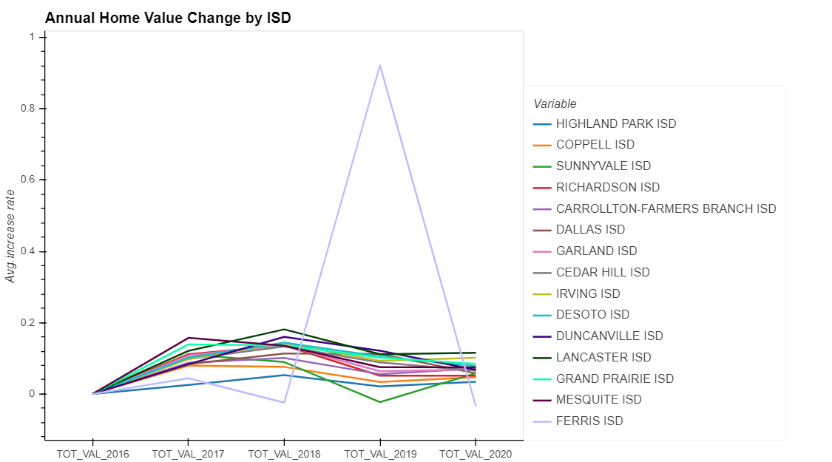
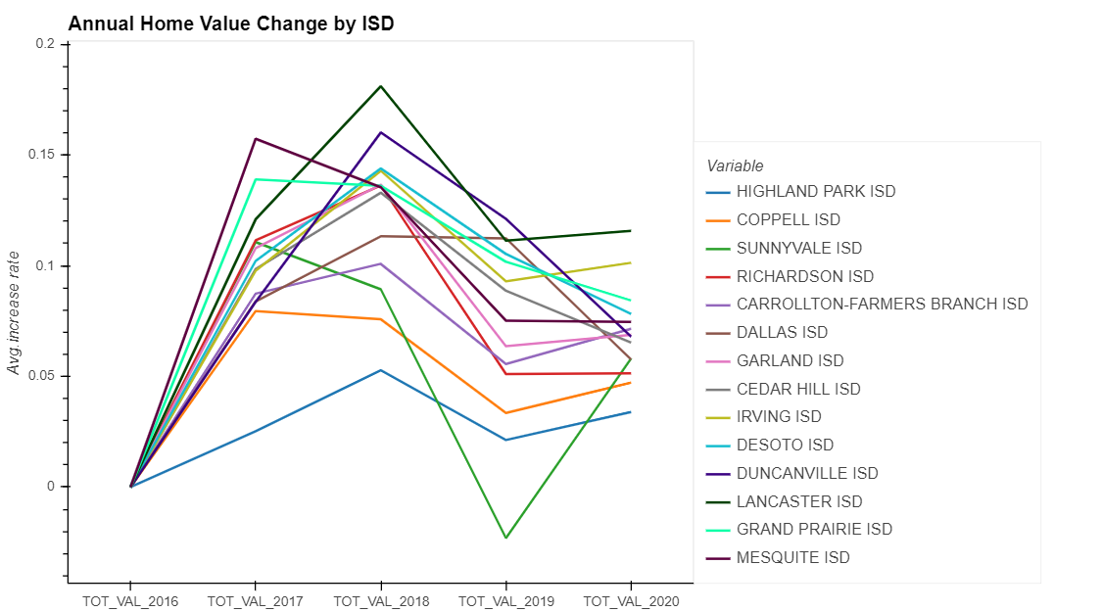
Data Cleansing
Notes:
Property Feature
Affordable, luxury, etc.
Bubble chart real time walkthrough (switch to jupyter)

Slide 13
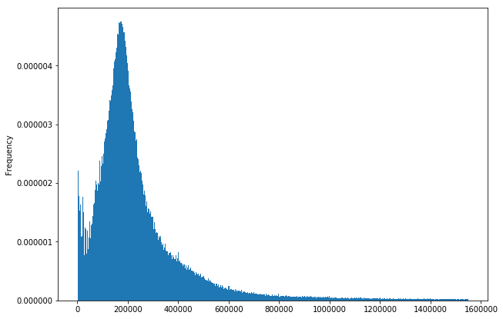
Data Distribution
Notes:
Property Feature
Affordable, luxury, etc.
Bubble chart real time walkthrough (switch to jupyter)

Slide 14
Questions
Notes:
Property Feature
Affordable, luxury, etc.
Bubble chart real time walkthrough (switch to jupyter)

